Slide 1
EN 410 Energy Management
Gurubalan Annadurai
guru.a@iitm.ac.in

Slide 2
Heat Exchanger
A heat exchanger is a device which allows transfer of heat energy from one fluid to another fluid, generally without mixing.
To get fluid streams to the right temperature for the next process (reactions often require feeds at high temp)
To condense vapours
To evaporate liquids
To recover heat to use elsewhere
To reject low-grade heat
To drive a power cycle

Slide 3
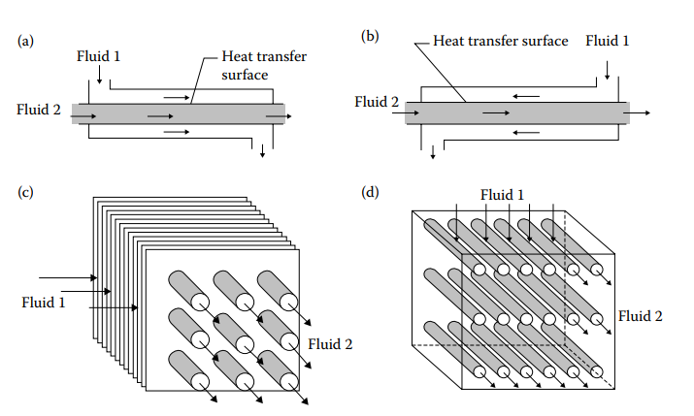
Types according to flow
Pumping power
Both at almost same exit temperature
Moderate wall temperature
Best performance (later proved based on LMTD)
Multi-pass requirement
Header arrangement

Slide 4
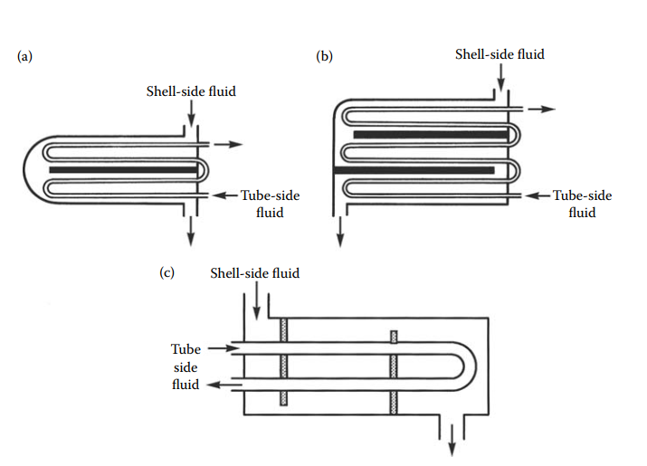
Multipass arrangement

Slide 5
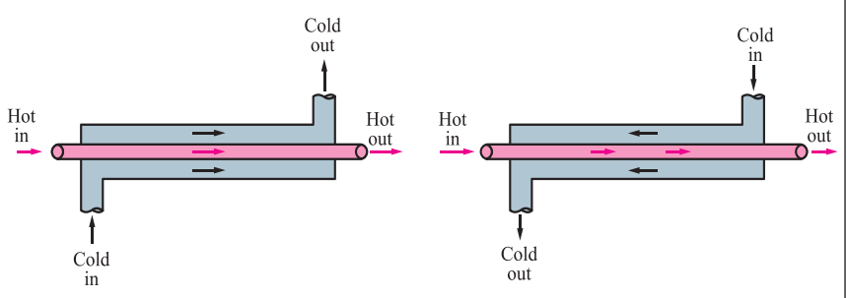
Types by construction – Double pipe HX
Simplest type has one tube inside another
Normal size - 0.25 to 200 m²
Multiple units are often used
Advantages
Easy to obtain counter-current flow
Can handle high pressure
Easy to maintain and repair
Modular construction
Disadvantage
Become expensive for large duties (above 1 MW)

Slide 6
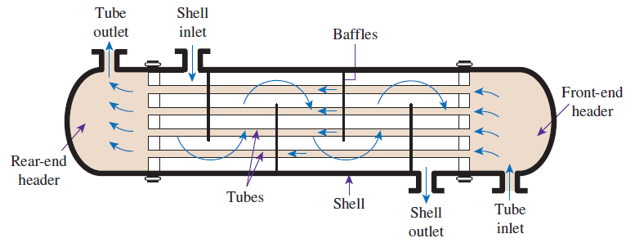
Shell and tube HX
Size per unit - 10 - 1000 m²
Easy to build multiple units
Advantages
Extremely flexible and robust design
Easy to maintain and repair
Can be designed to be dismantled for cleaning
Many suppliers
Disadvantages
Require large plot (footprint) area - often need extra space to remove the bundle
Flow-induced vibrations, noise, thermal stresses, and entry impingement problems

Slide 7
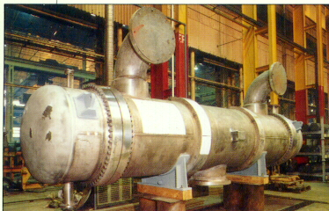
Scope of shell and tube HX
Maximum pressure
300 bar (abs) on shell side
1400 bar (abs) on tube side
Temperature range
-100 to 600ºC (-150 to 1100ºF)
possibly wider with special materials
Fluid limitations
Few since can be built of many metals

Slide 8
Allocation of Fluids
Put dirty stream on the tube side - easier to clean inside the tubes
Put high pressure stream in the tubes to avoid thick, expensive shell
When special materials required for one stream, put that one in the tubes to avoid expensive shell
Cross flow gives higher coefficients than in plane tubes, hence put fluid with lowest coefficient on the shell side

Slide 9
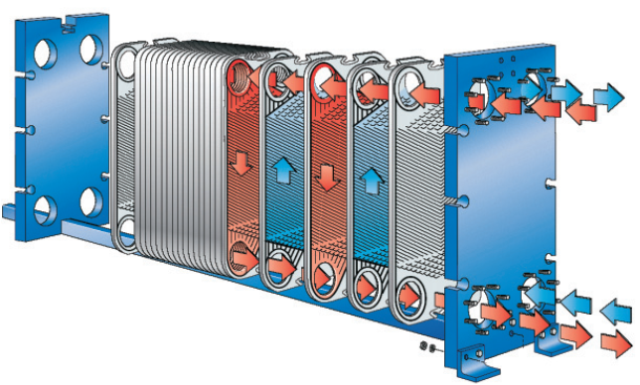
Plate HX
“Plate exchanger” normally refers to a gasketed plate- and-frame exchanger
Advantages
High heat transfer coefficients
Even distribution of heat transfer no hot/cold spot
Contains small amount of fluid which is useful for quick transient
Low pressure drop
Easy cleaning
Disadvantages
Due to gasket issue, not favourable for high vacuum, erosive duties
Relatively low pressure capability

Slide 10
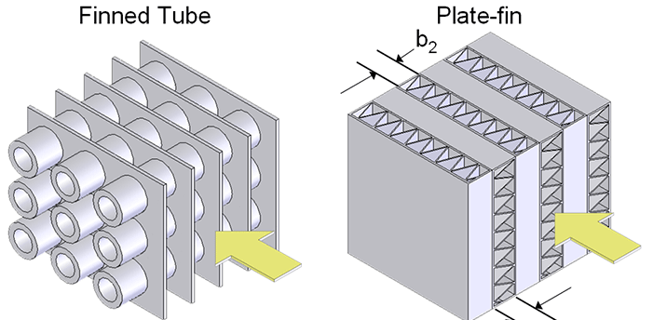
Extended surface heat exchangers
High effectiveness is needed (>98%)
Compactness > 700m²/m³
High pressure drop

Slide 11
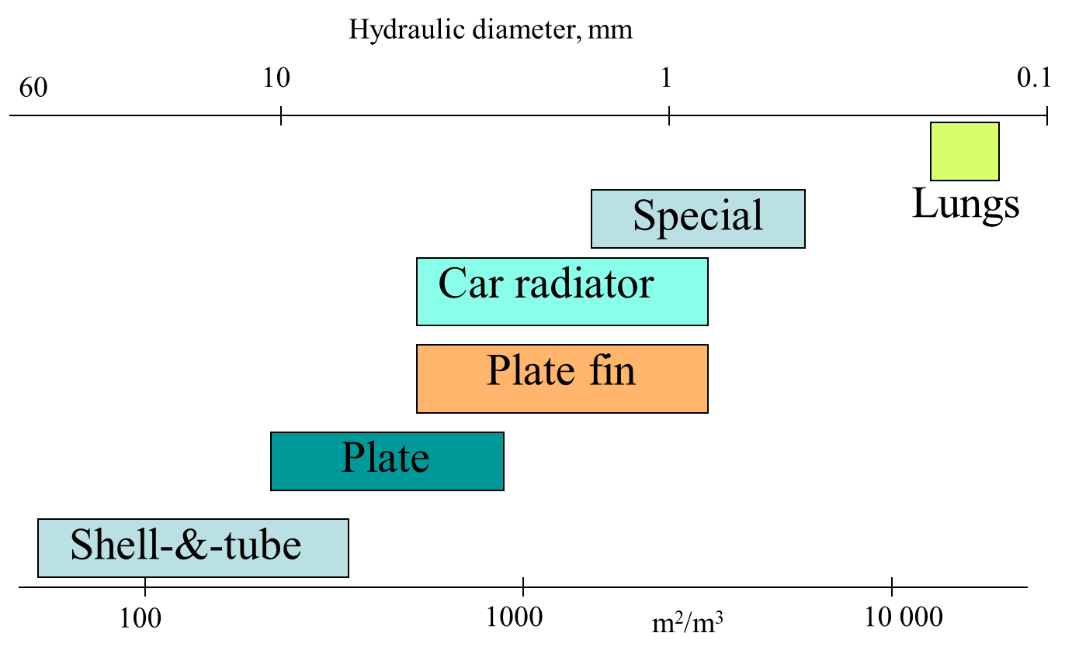
Compactness
Can be measured by the heat-transfer area per unit volume or by channel size
Conventional exchangers (shell and tube) have channel size of 10 to 30 mm giving about 100 m²/m³
Plate-type exchangers have typically 5 mm channel size with more than 200 m²/m³
More compact types available

Slide 12
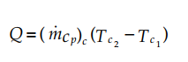
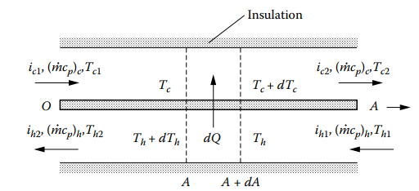
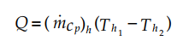
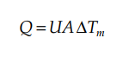
Heat Exchanger Analysis
i – enthalpy
T – Temperature
m – mass flow rate
Cp – specific heat capacity
Q – Heat transfer

Slide 13
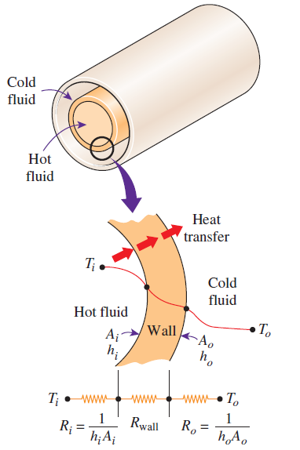
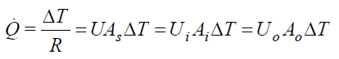
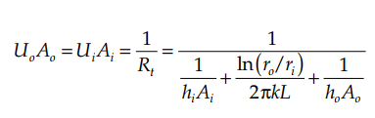
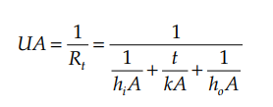
Overall heat transfer coefficient, U (W/m²⋅°C)
For tubular type
For plate type

Slide 14
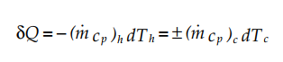
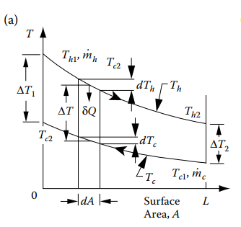
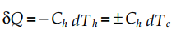
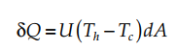
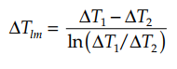
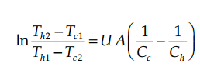
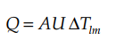
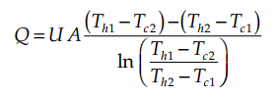
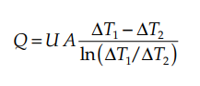
LMTD Method for Heat Exchanger Analysis

Slide 15
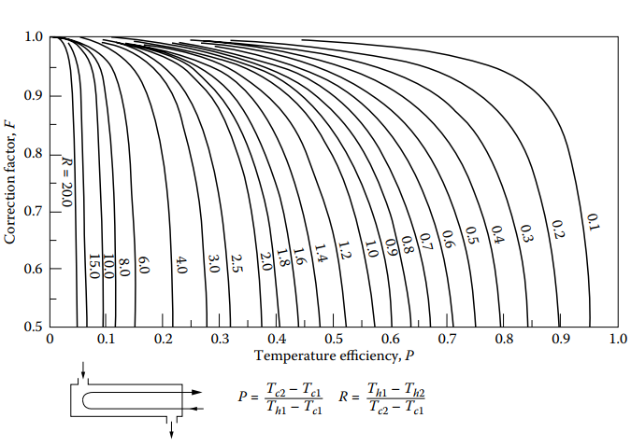
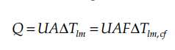
Analysis for other flow arrangement
F – Correction factor

Slide 16
Procedure for selecting heat exchanger
With the LMTD method, the task is to select a heat exchanger that will meet the prescribed heat transfer requirements. The procedure for the selection process is
Select the type of heat exchanger suitable for the application.
Determine any unknown inlet or outlet temperature and the heat transfer rate using an energy balance.
Calculate the log mean temperature difference ΔT_{lm} and the correction factor F, if necessary.
Obtain (select or calculate) the value of the overall heat transfer coefficient U.
Calculate the heat transfer surface area A_{s} .
The task is completed by selecting a heat exchanger that has a heat transfer surface area equal to or larger than A_{s}.

Slide 17
Effectiveness–NTU method
A second kind of problem encountered in heat exchanger analysis is the determination of the heat transfer rate and the outlet temperatures of the hot and cold fluids for prescribed fluid mass flow rates and inlet temperatures when the type and size of the heat exchanger are specified.

Slide 18
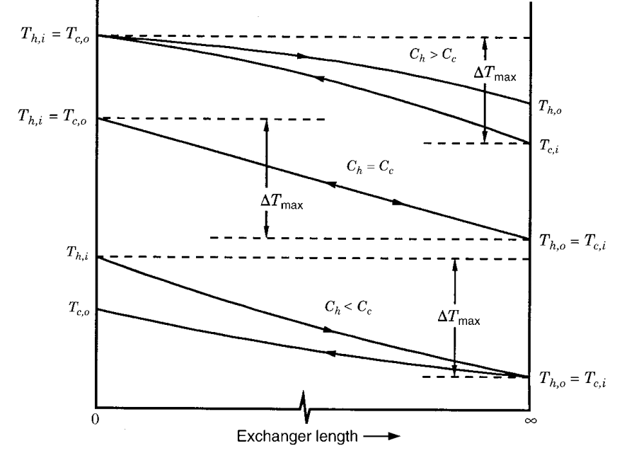
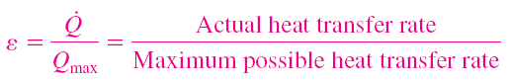
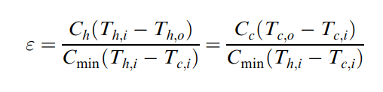
Effectiveness

Slide 19
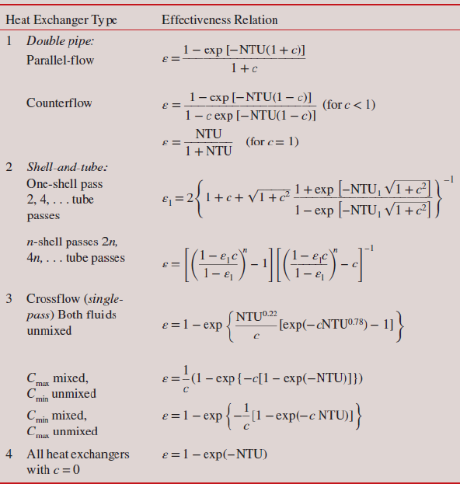
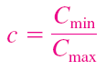
Effectiveness–NTU method
For specified values of U and C_{min}, the value of NTU is a measure of the surface area A_{s}. Thus, the larger the NTU, the larger the heat exchanger.
Capacity ratio

Slide 20
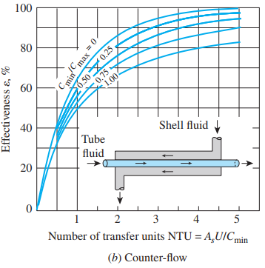
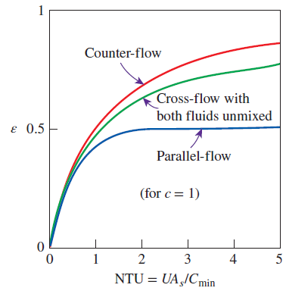
Effectiveness–NTU method
ε increases with increasing values of NTU for a specified C*
ε increases with decreasing values of C* for a specified NTU
For ε < 40%, the capacity rate ratio C* does not have a significant influence on ε
When C* =0?

Slide 21
Fouling
Fouling is general term that includes any kind of deposits that appears on the heat exchanger surface over the lifetime of the exchanger.
It introduces an additional resistance to heat transfer
Sometimes the deposit is heavy enough to interfere with the flow and increase the pressure drop
Keeping velocities sufficiently high to avoid deposits
Avoiding stagnant regions where dirt will collect
Avoiding hot spots where coking or scaling might occur
Avoiding cold spots where liquids might freeze or where corrosive products may condense from gases

Slide 22
Selection of HX
The proper selection of a heat exchanger depends on several factors:
Heat Transfer Rate
Cost
Pumping Power
Size and Weight
Type
Materials

Slide 23
Waste heat recovery options
The waste heat of hot exhaust gases from a heat treating furnace at 427℃ with a flow rate of 1.72 kg/s. The minimum allowable exit temperature is 204℃. Specific heat is 1.05 kJ/kg.K. The furnace burns coal whose heating value is 26749 kJ/kg with an air fuel ratio of 20, and has an efficiency of 75%. There are two options
Preheat the combustion air entering the furnace at 27℃ (U = 23 W/m²K)
Generate steam at 8 bar (2770 kJ/kg )at the rate of 0.136 kg/s. Liquid water enters the waste heat boiler at 116℃ (485 kJ/kg ). U is 142 W/M2k
Calculate the fuel savings, and required surface area and effectiveness of the heat exchanger for both options.

Slide 24
References
Heat Exchangers - Selection, Rating, and Thermal Design
By Sadik Kakaç, Hongtan Liu, Anchasa Pramuanjaroenkij
Heat And Mass Transfer Fundamentals And Applications
by Yunus A. Cengel and Afshin G. Ghajar

